Slide 1
Data Visualization - Inflation vs. Minimum Wage
Sam Hoadley, Gurjinder Singh, Ian Czech

Slide 2
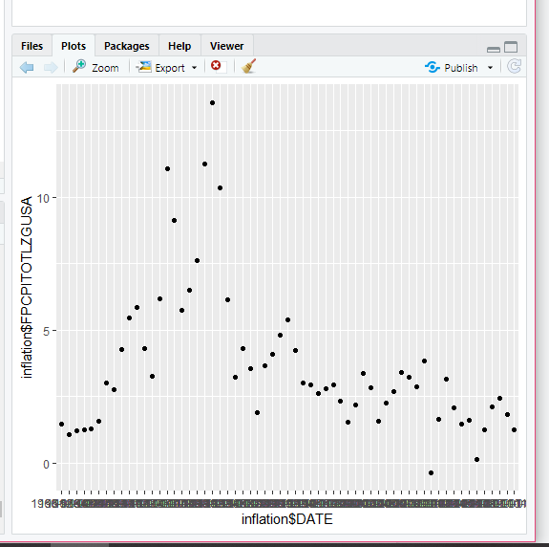
Percentage Increase of Inflation by Year 1960-2020

Slide 3
Percentage Increase of Inflation by Year
This graph show that except for one year, inflation has increased by some degree every year.
Analysis

Slide 4
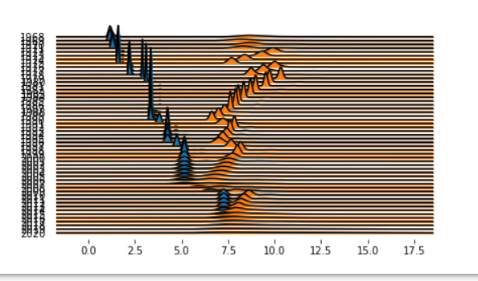
Effective Minimum Wage 1968-2020
Blue: What it was worth that year
Orange: Converted to 2020 dollars

Slide 5
Effective Minimum Wage
This graph show the difference between the effective minimum wage of all states and U.S territories for each year and what the value would be when converted to 2020 dollars.
Despite the fact that inflation keeps increasing, the minimum wage largely stays around the same value overall despite increasing.
Analysis

Slide 6
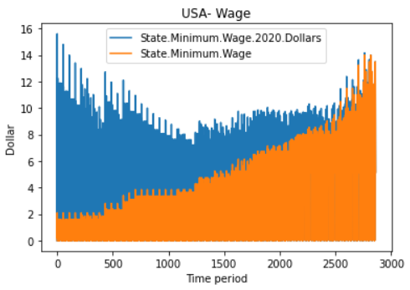
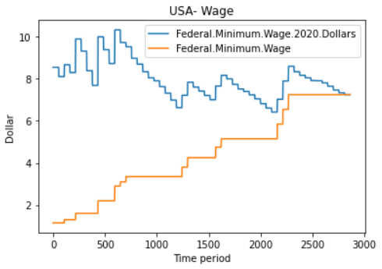

Slide 7
Minimum Wage
These graphs show the difference between the State Minimum wage 2020 dollars Vs. State Minimum wage and Federal minimum wage 2020 dollars Vs. Federal minimum wage. Each show the overall time period of the states wages. We can see how the Federal minimum wage and State minimum wage slowly equals the same wage in the following year of 2020
Analysis

Slide 8
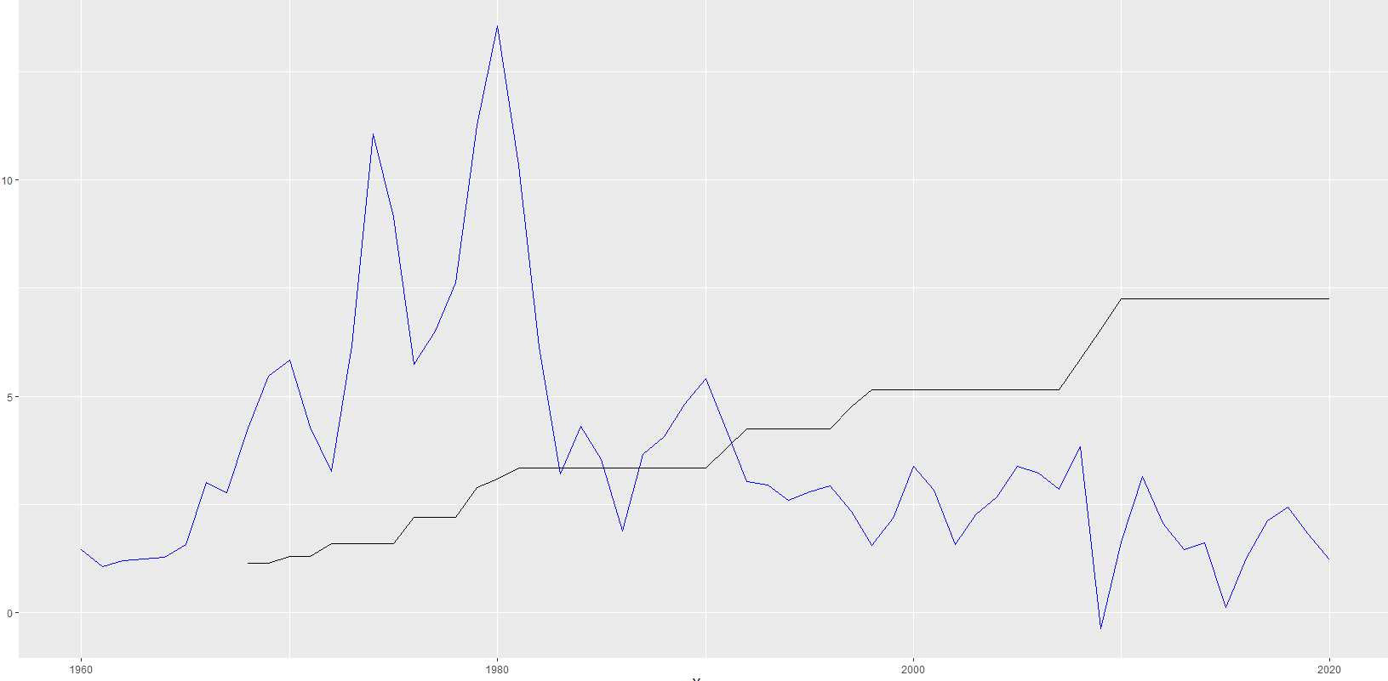
Inflation vs. Federal Minimum Wage (Non-Adjusted) 1960-2020
Blue: Inflation
Orange: Non-Adjusted Federal Minimum Wage

Slide 9
Inflation vs. Federal Minimum Wage (Non-Adjusted)
We chose this visualization (line graph) because it was easy to see data and how the inflation spikes and dips versus the rise of minimum wage.
From this, we can conclude that inflation was rising until the 80’s, and fell much lower after that, including a very brief dip below 0 around the time of the 2008-09 recession. We can see the slow and steady rise of minimum wage, and when the biggest jump happened around the 2008-09 recession. We can also see the relationship between when minimum wage was both higher and lower than inflation.
Analysis

